Slide 1
A Case Study of Neural Network-Driven 4D Seismic Interpretation for CO₂ Storage Monitoring
Presented by: Darshitaben Patel Committee Chairs: Prof. Yunyue Elita Li & Prof. Qianlai Zhuang Committee Member: Prof. Wen-wen Tung
Department of Earth, Atmospheric, and Planetary Sciences
Geodata Science for Professionals Master's Program

Slide 2
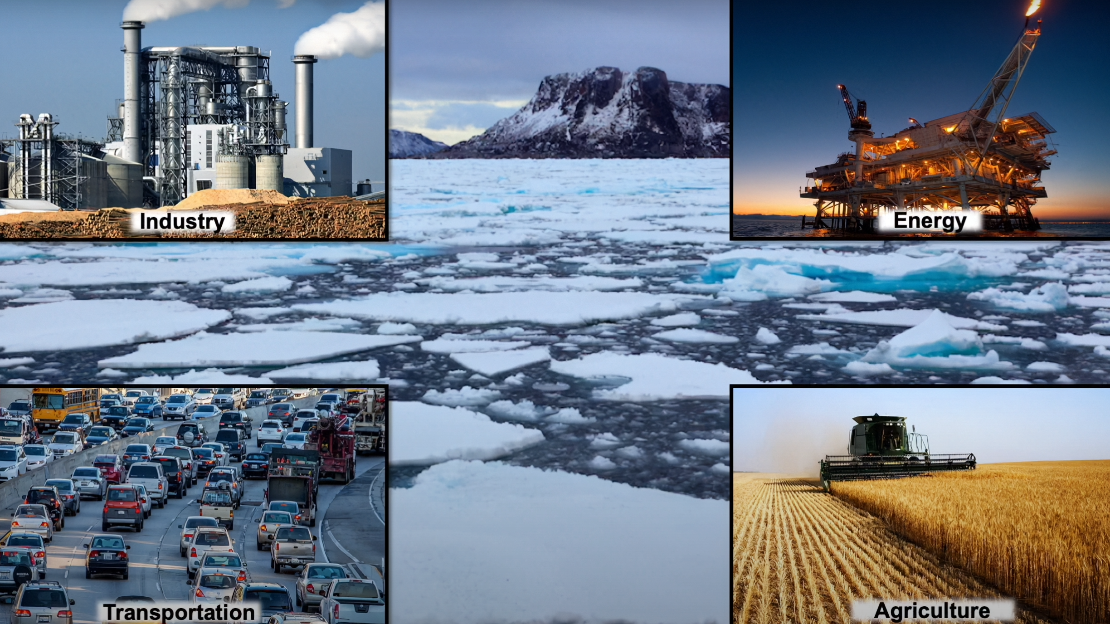

Slide 3
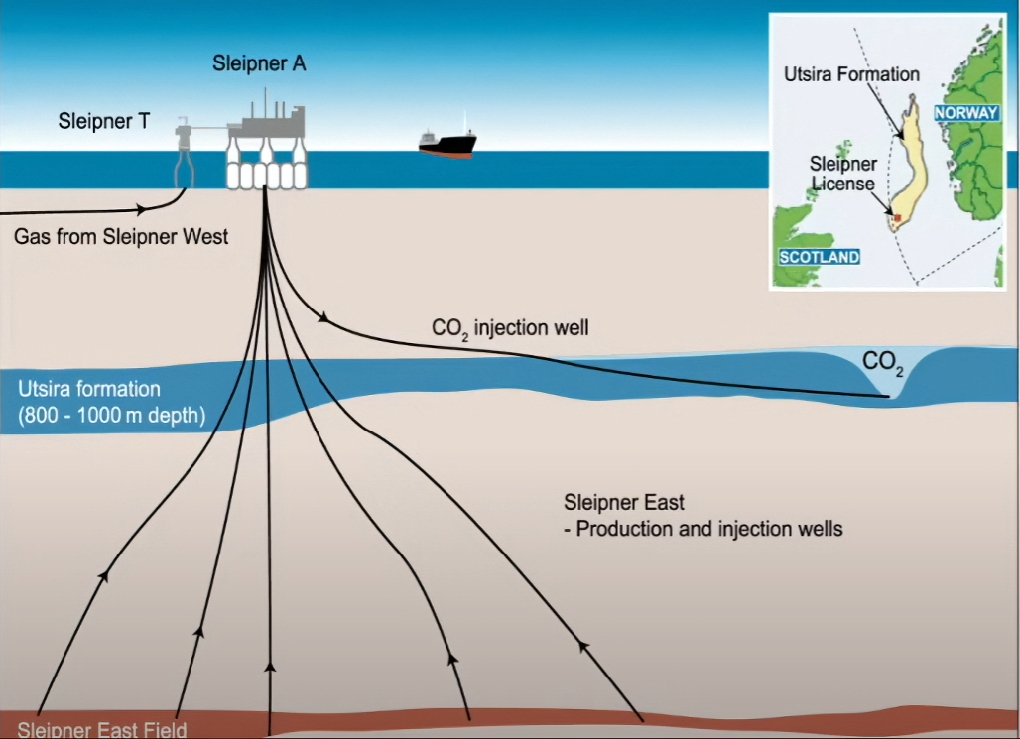
DATASETS: Sleipner CO2 Injection Project
First industrial-scale offshore CO₂ storage project
Utilizes a deep saline aquifer as the storage reservoir
CO₂ injection began in 1996
Over 23 million tonnes stored as of 2025
In the book: IPCC Special Report on CO2 capture and sequestration. (pp.195–265)

Slide 4
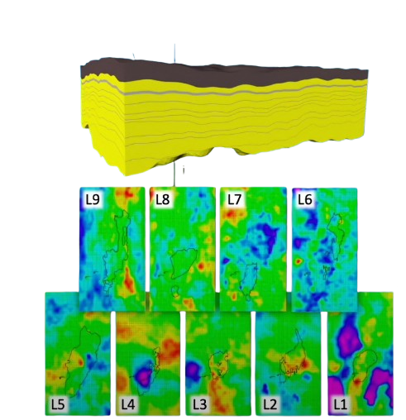
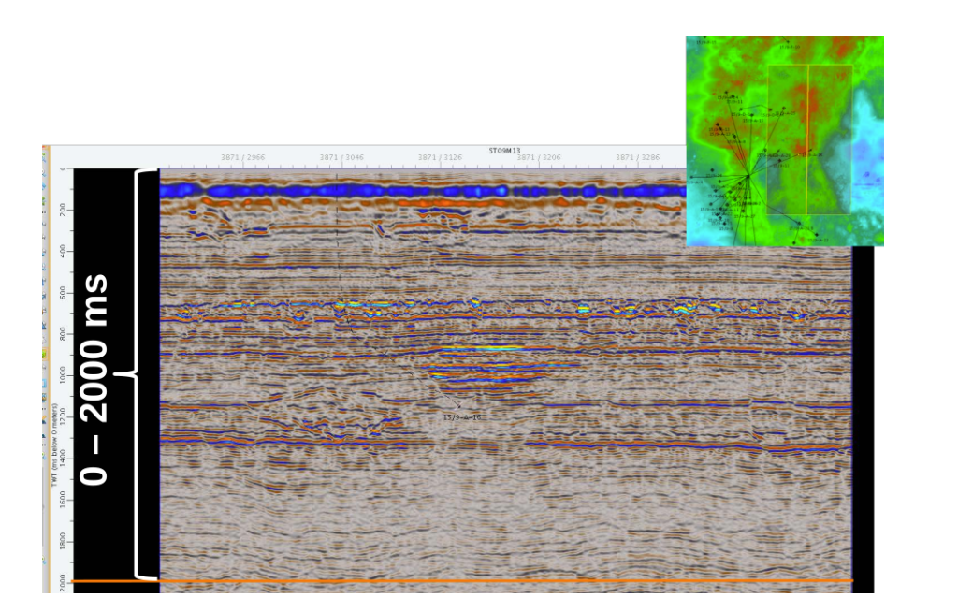
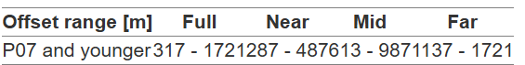
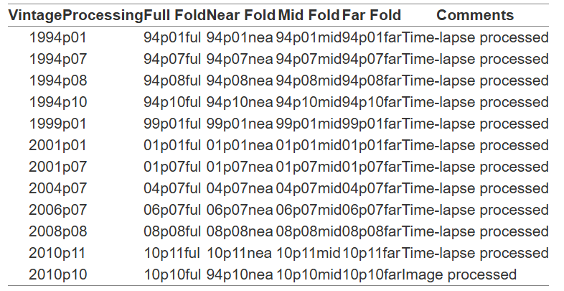
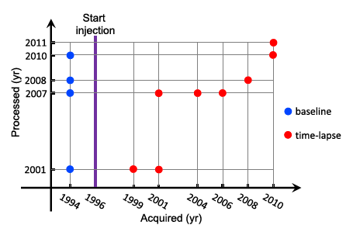
DATASETS: Sleipner CO2 Injection Project
Benchmark model
interface depth and interval velocity
Plume Boundary

Slide 5
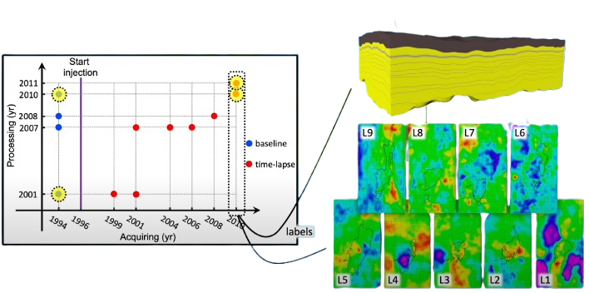
DATASETS: Sleipner CO2 Injection Project
Benchmark model
interface depth and interval velocity
Plume Boundary

Slide 6
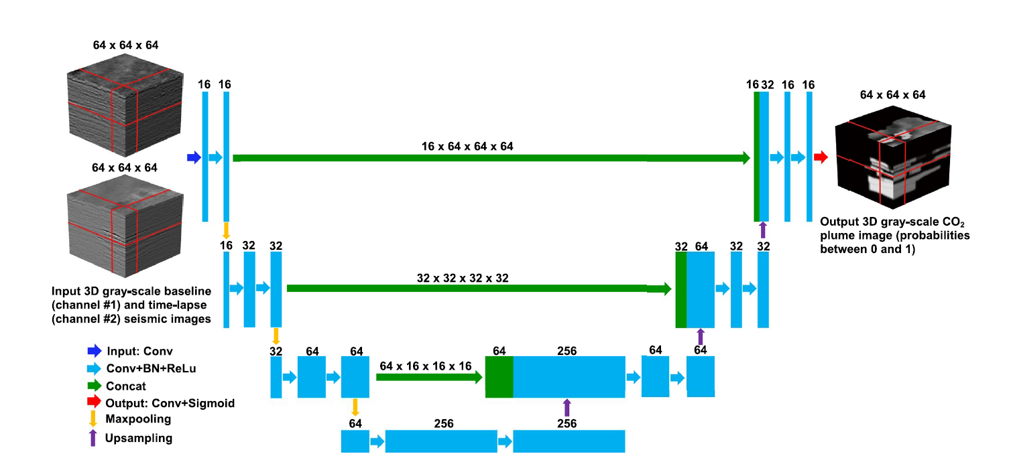
NN Architecture:

Slide 7
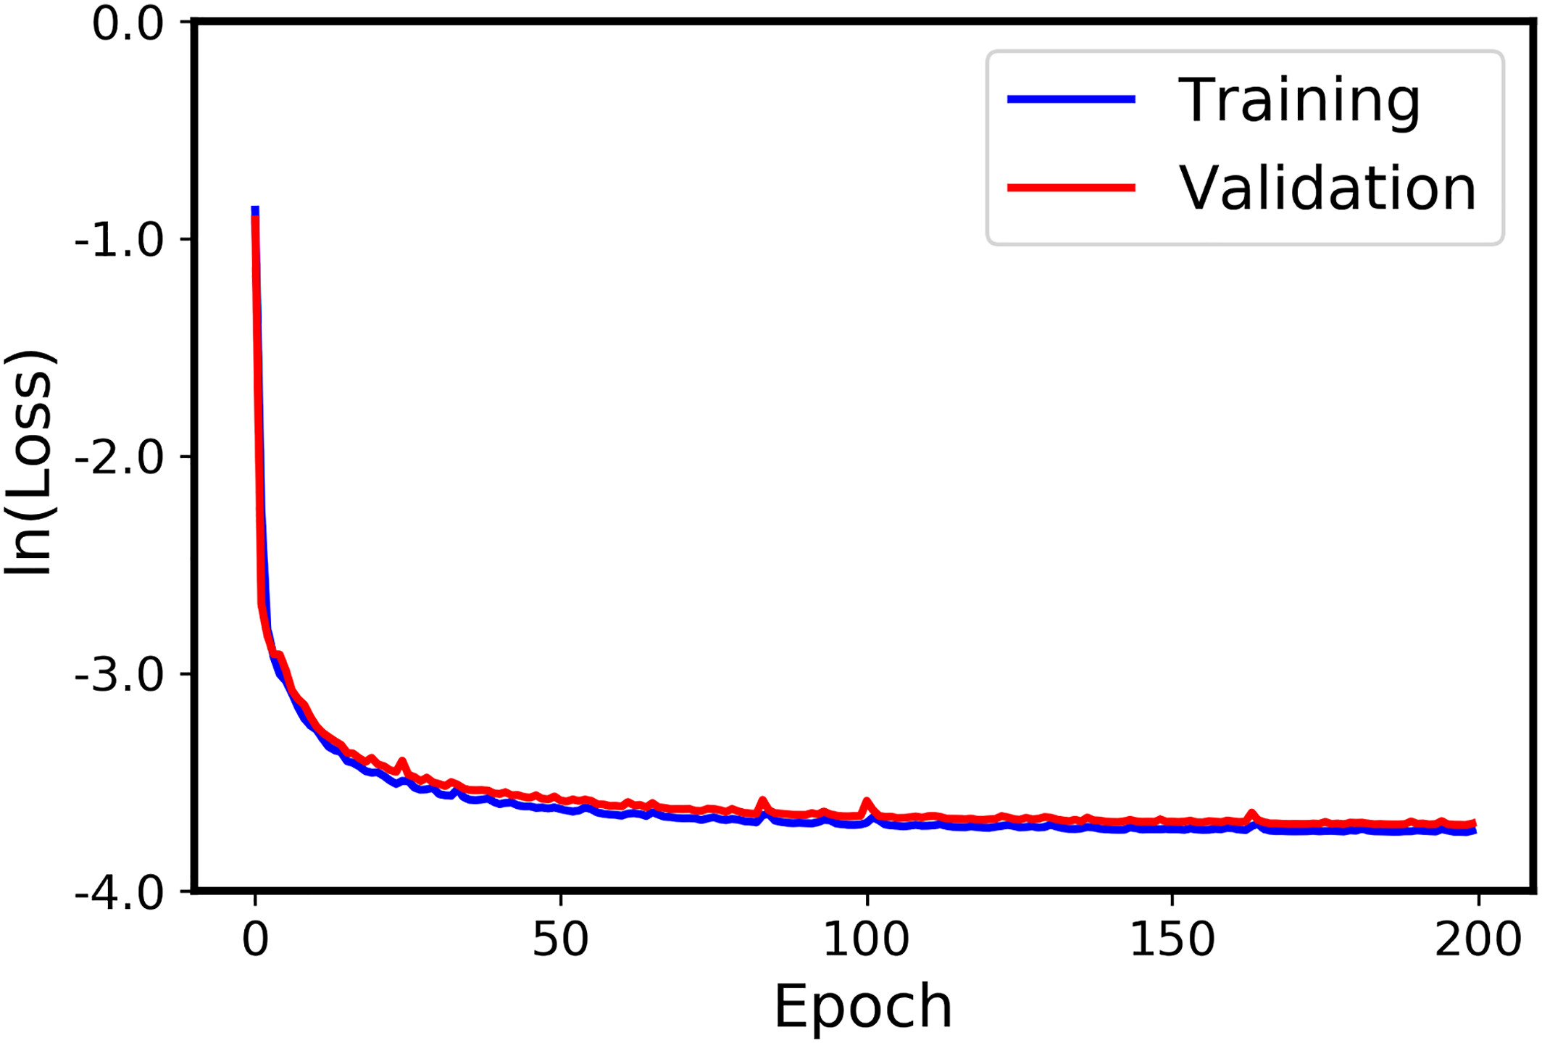
Training & Validation:
Batch size of 30 for
a total of 1500 training samples
Adam optimizer with
learning rate of 0.0002
200 epochs using 3.08 hours (NVIDIA A30, 24G)
CUDA 12.7, 23.5 GB used @ 28°C

Slide 8
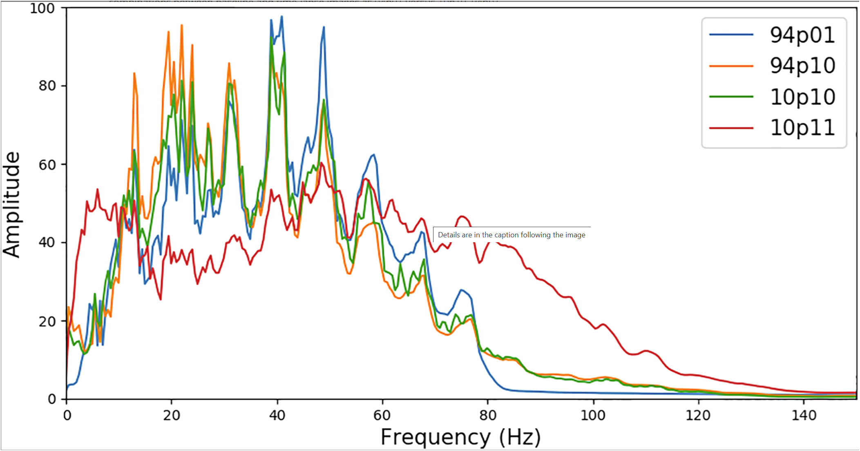
Comparison among amplitude spectra of 94p01, 94p10, 10p10, and 10p11:

Slide 9
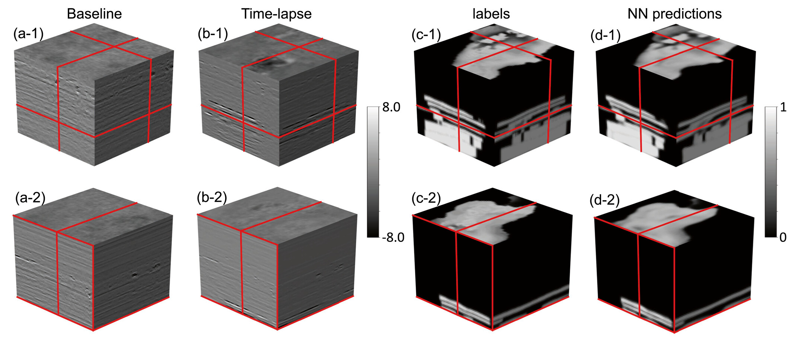

Slide 10
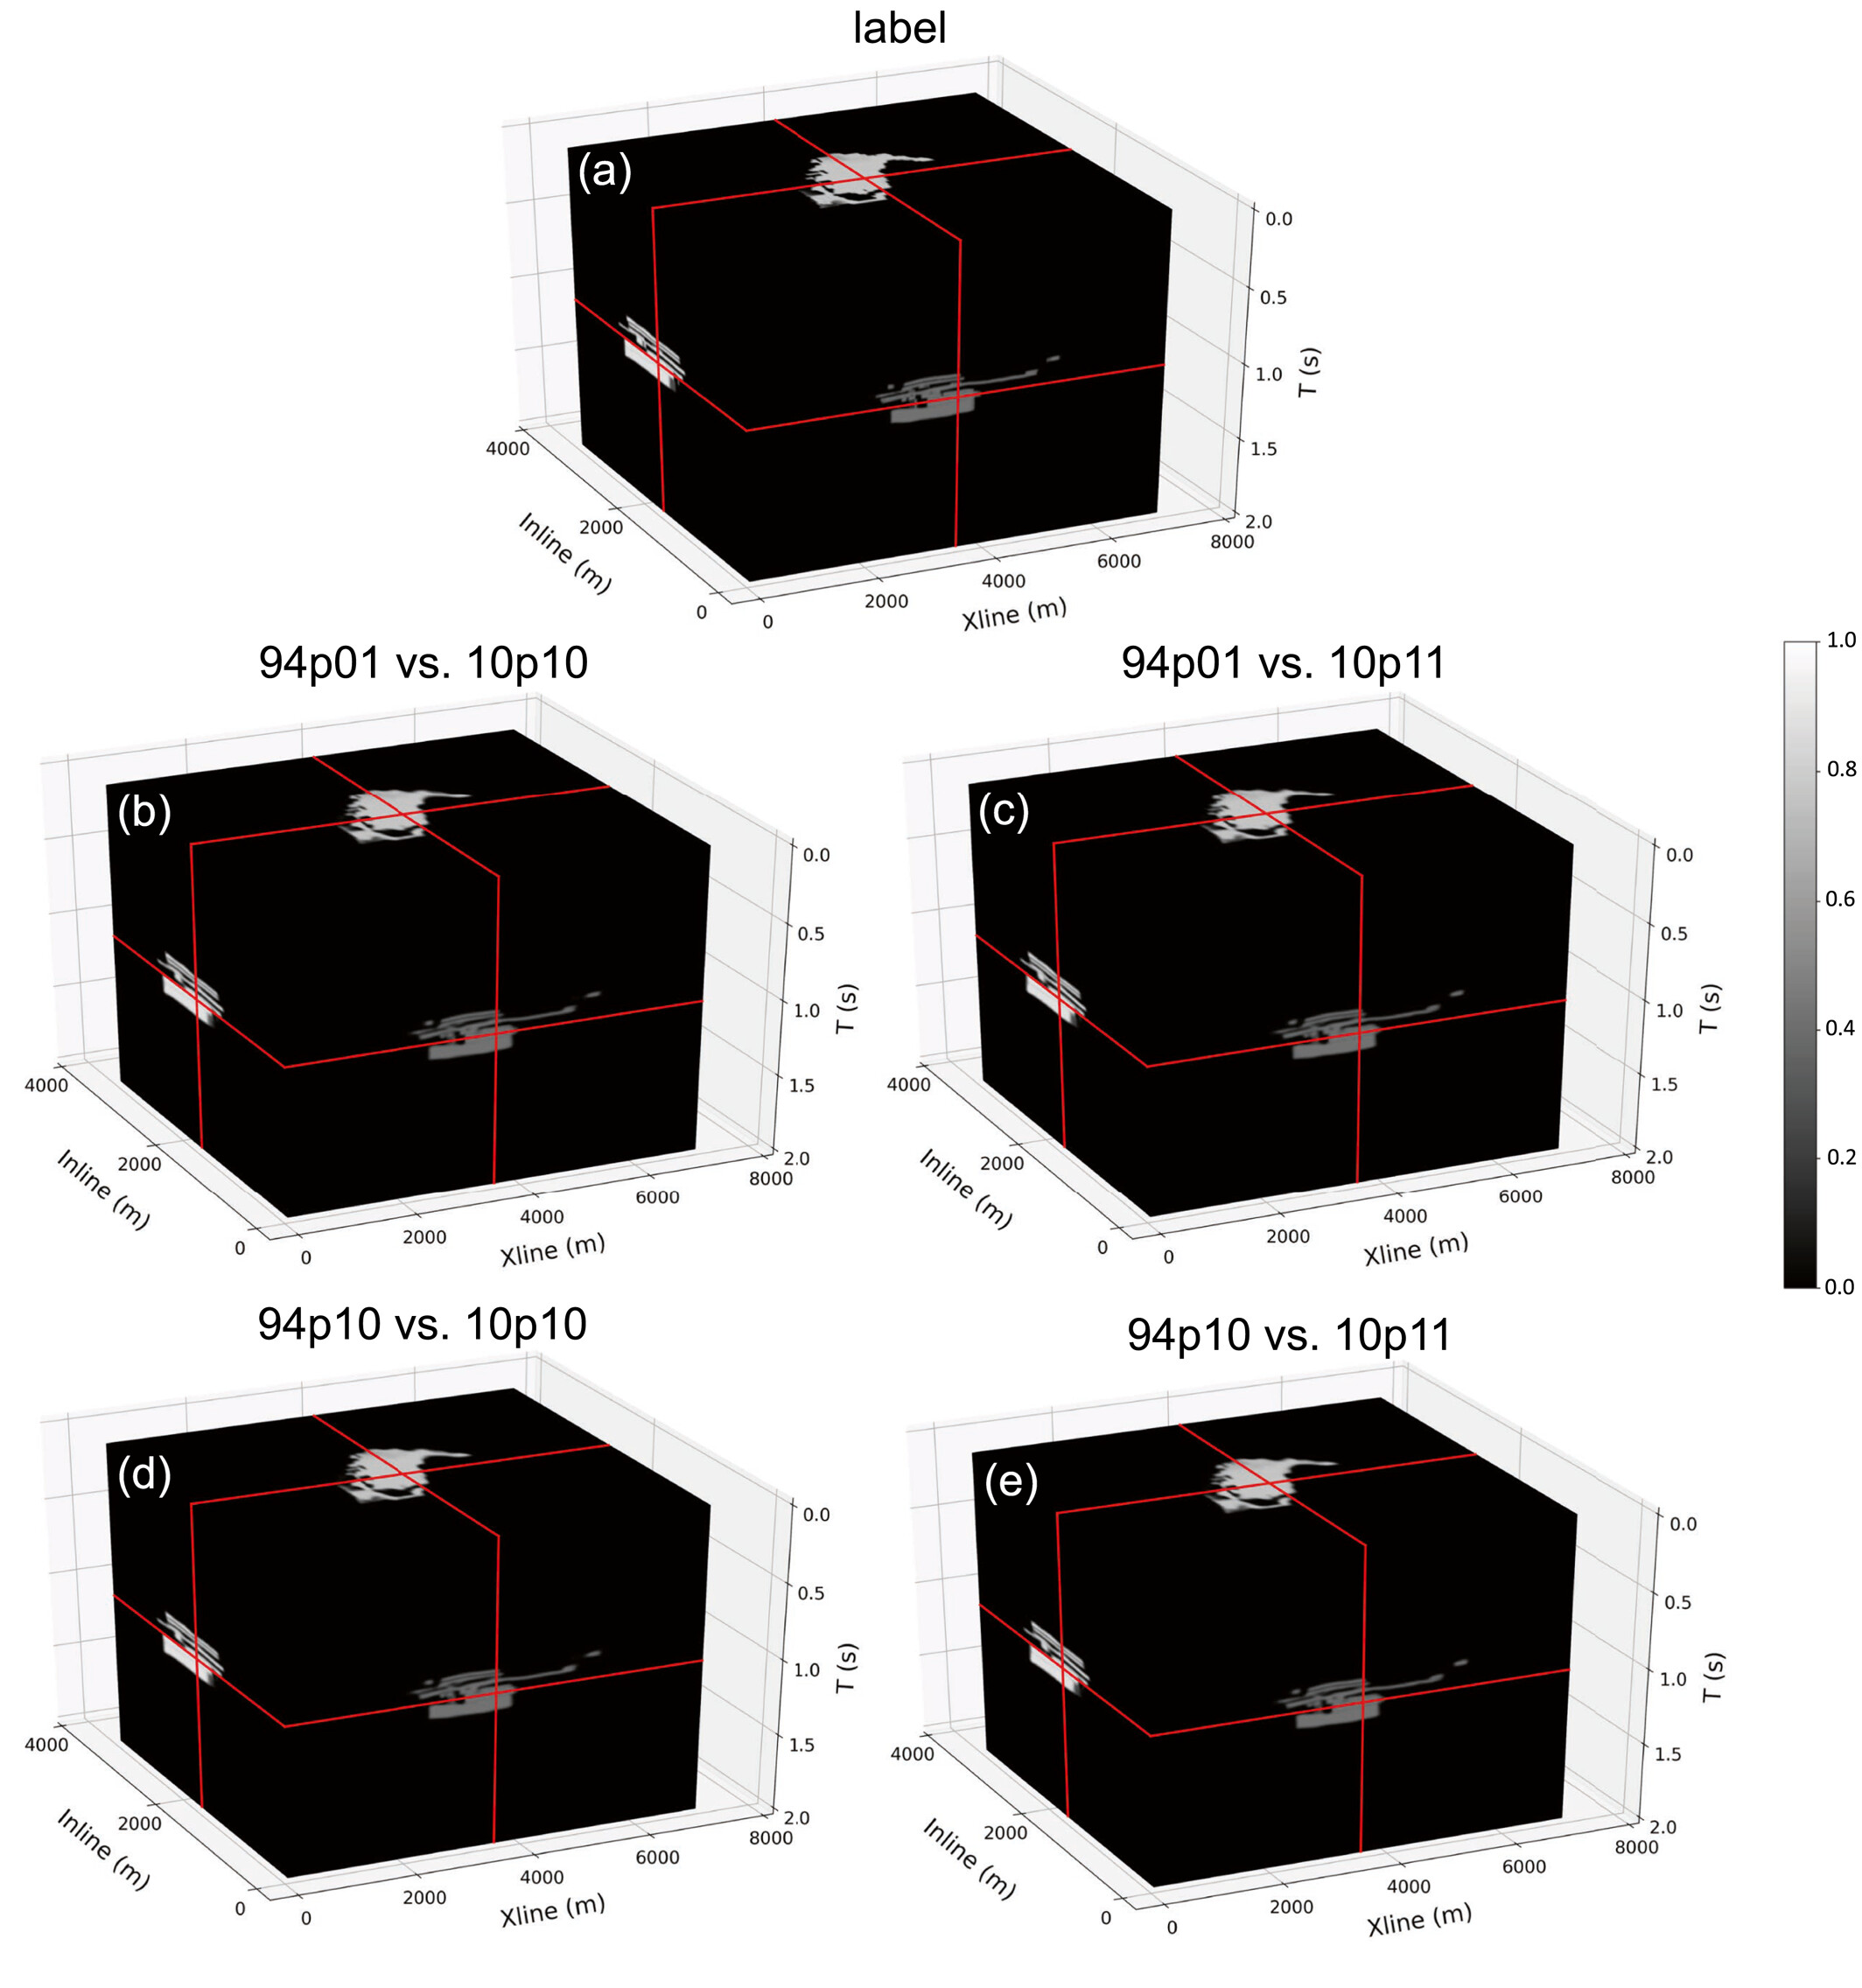
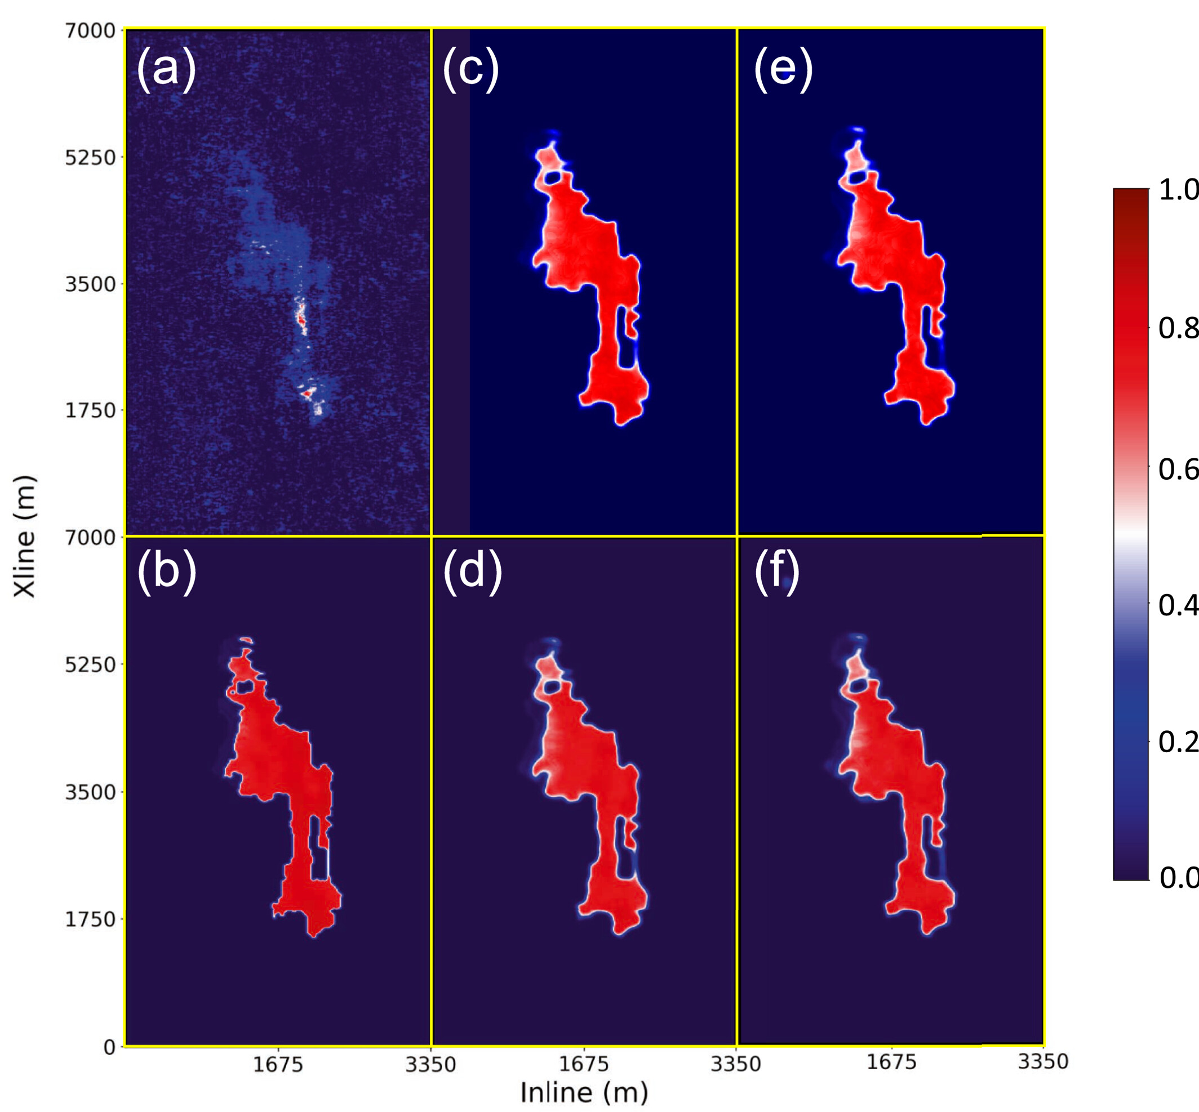
Robustness Test:
Comparison between
The label and (b–e) the reconstructed CO₂ distributions based on NN predictions using four different combinations of baseline and time-lapse images as inputs.
The reconstructed CO₂ distribution is obtained by weighted summation of the overlapped NN predictions of the CO₂ distribution probability.

Slide 11
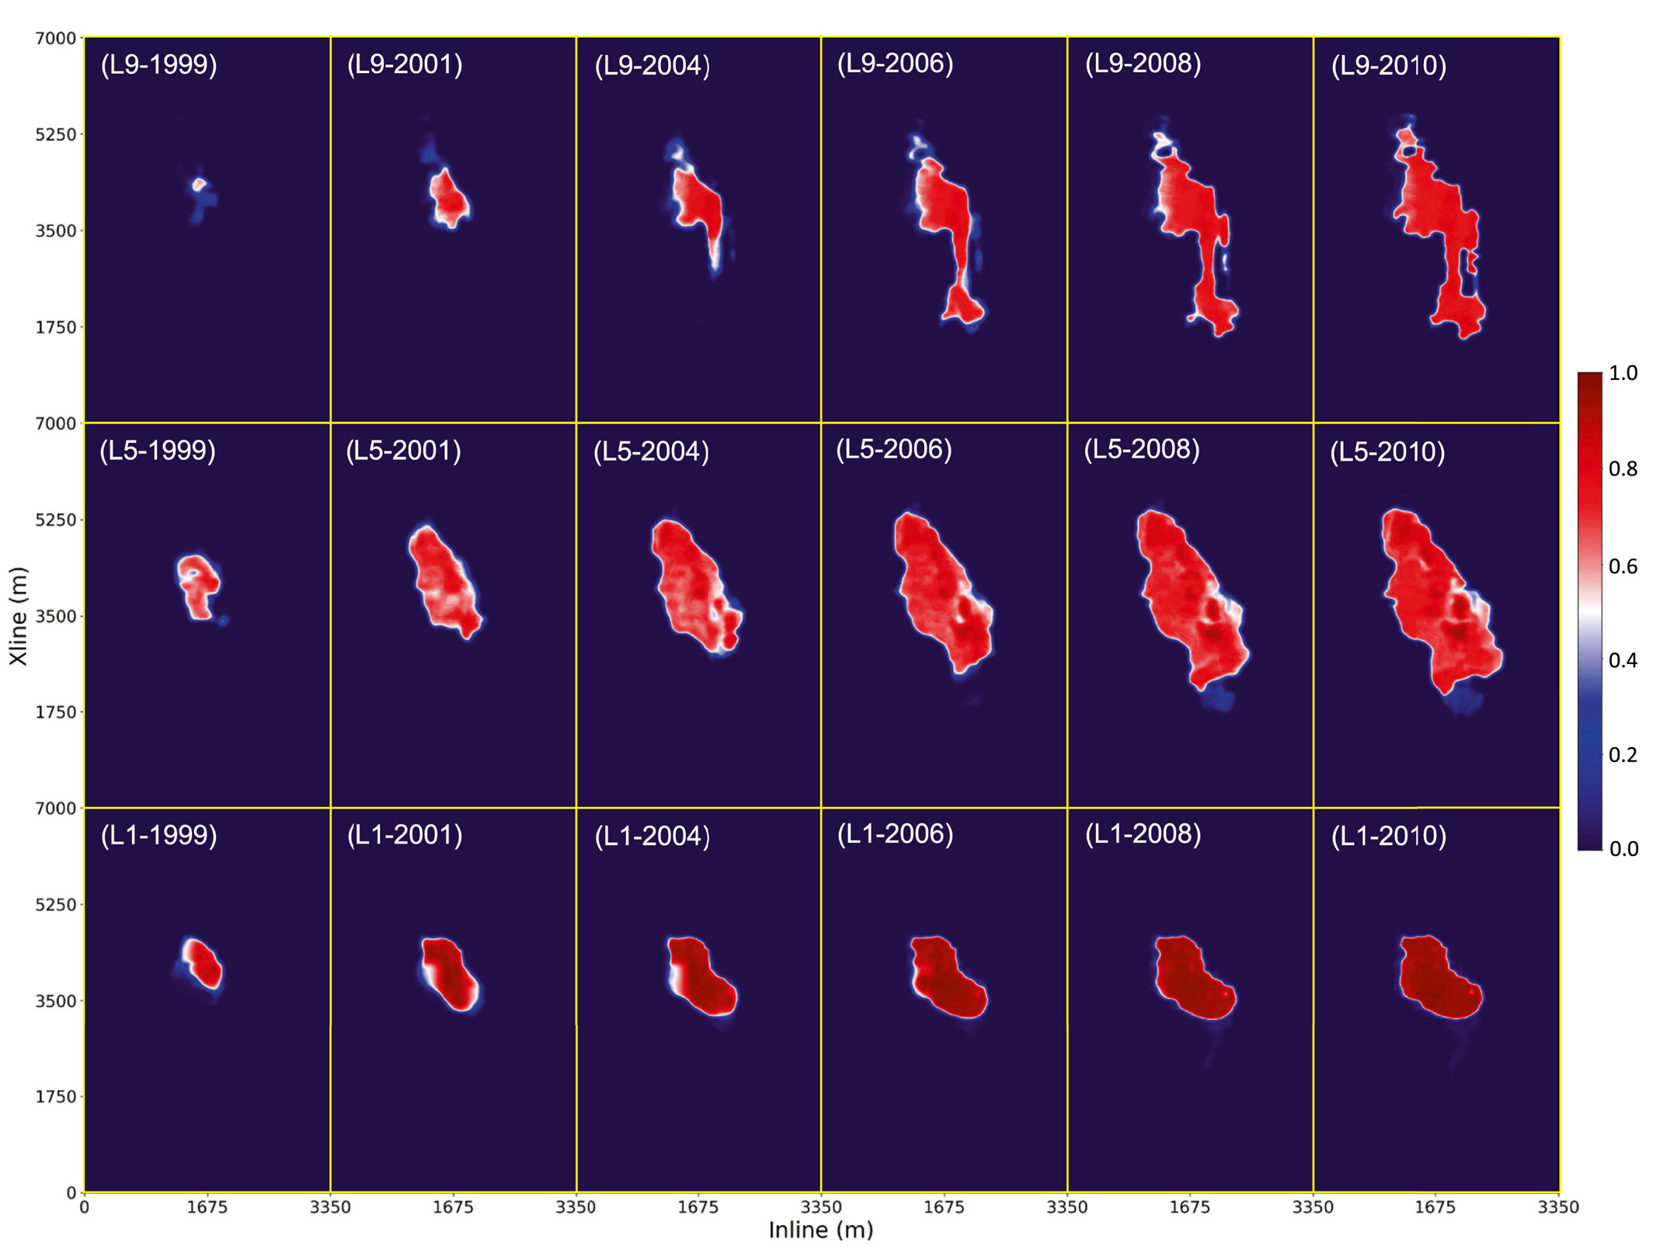
Consistency Test:
NN interpreted the CO₂ plume expanding along L9 (top), L5 (middle), and L1 (base) layers of the Utsira Formation, from 1999 to 2010. The color represents the probability of CO₂ distribution within each layer, where red indicates high probability and blue indicates low probability, as the color bar illustrates on the right-hand side.

Slide 12
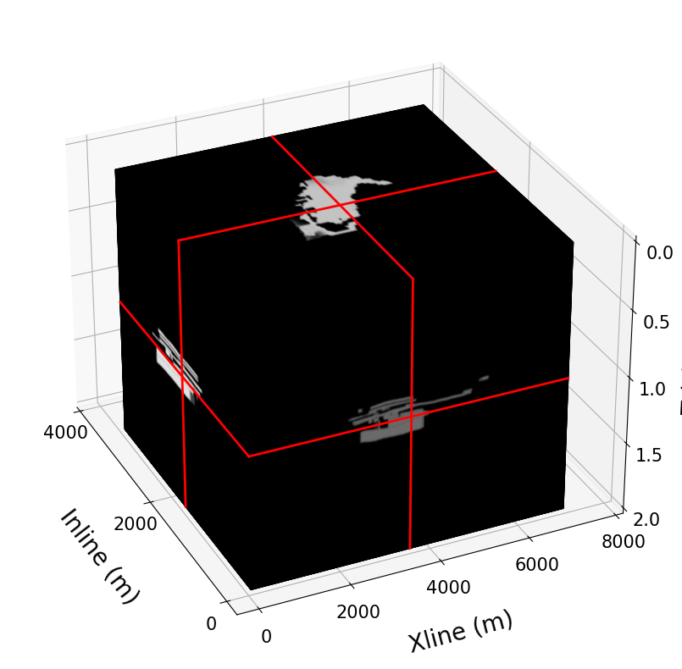

Results:
Label
NN
Prediction

Slide 13
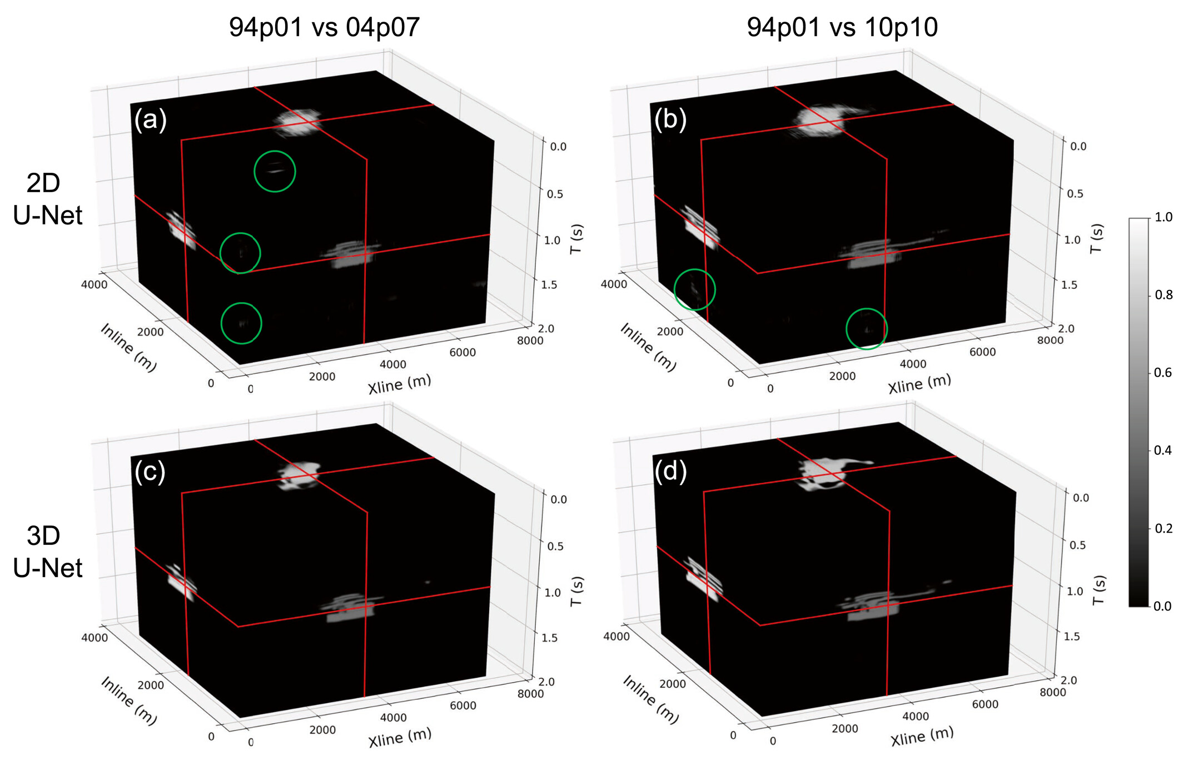
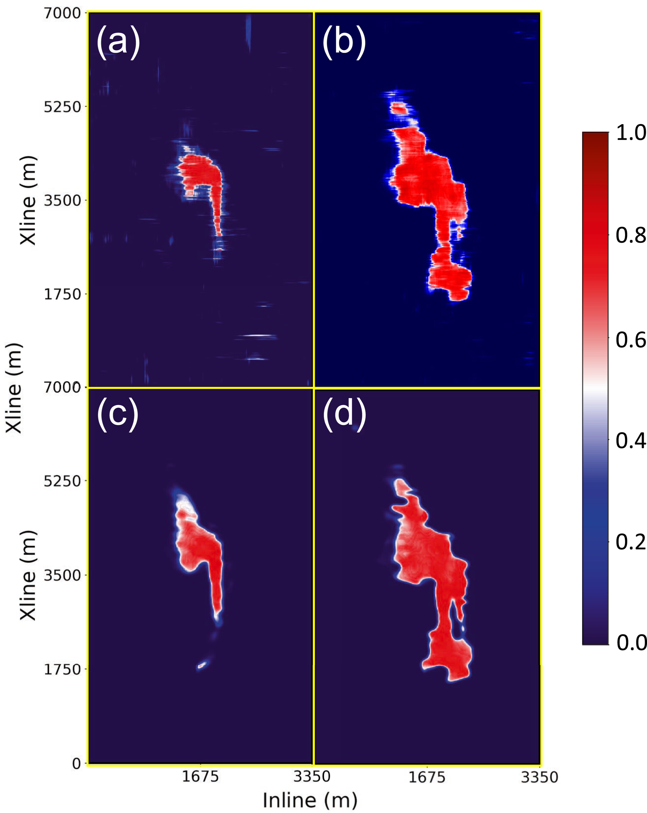
Reconstructed 3D CO₂ distributions from NN:
NN interpreted CO₂ distributions

Slide 14
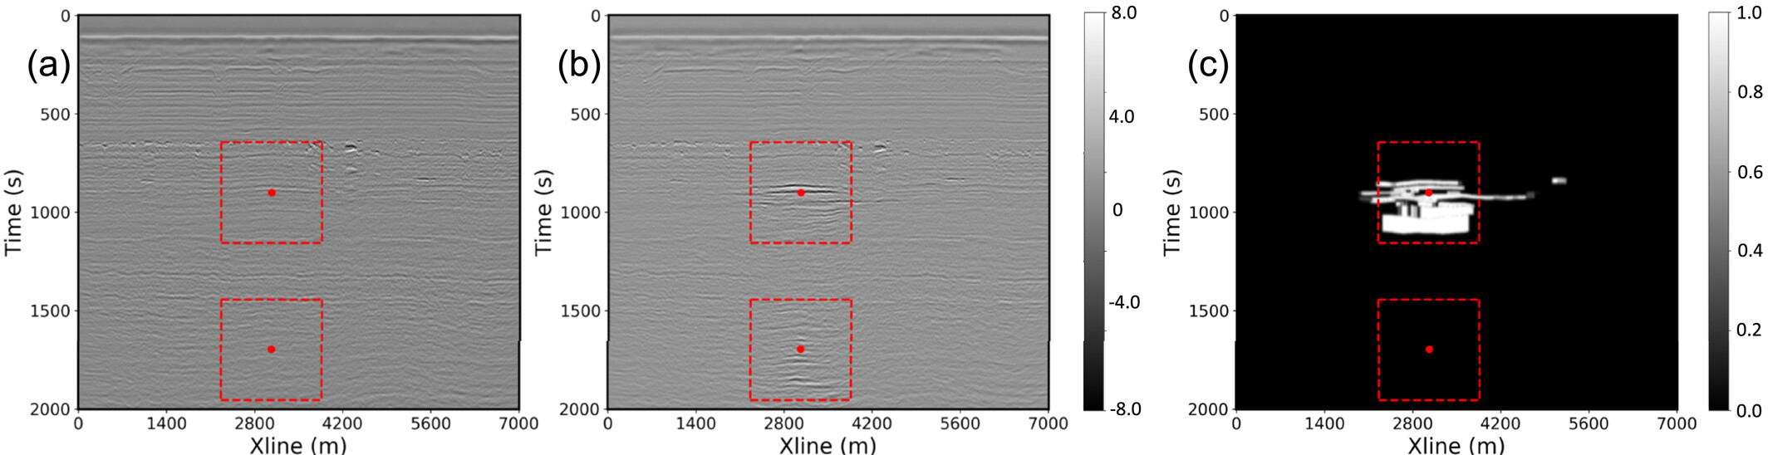
Analysis for NN Interpretation Standards:
The inline assembly at 1,625 m for (a) baseline and (b) time-lapse images from 94p10 and 10p10, along with the (c) CO₂ distribution label. The red dots and dashed lines indicate the centers and boundaries of the sampled cubes within the inline assembly. The lower area shows image artifacts due to surface-related multiples from CO₂-saturated layers.

Slide 15
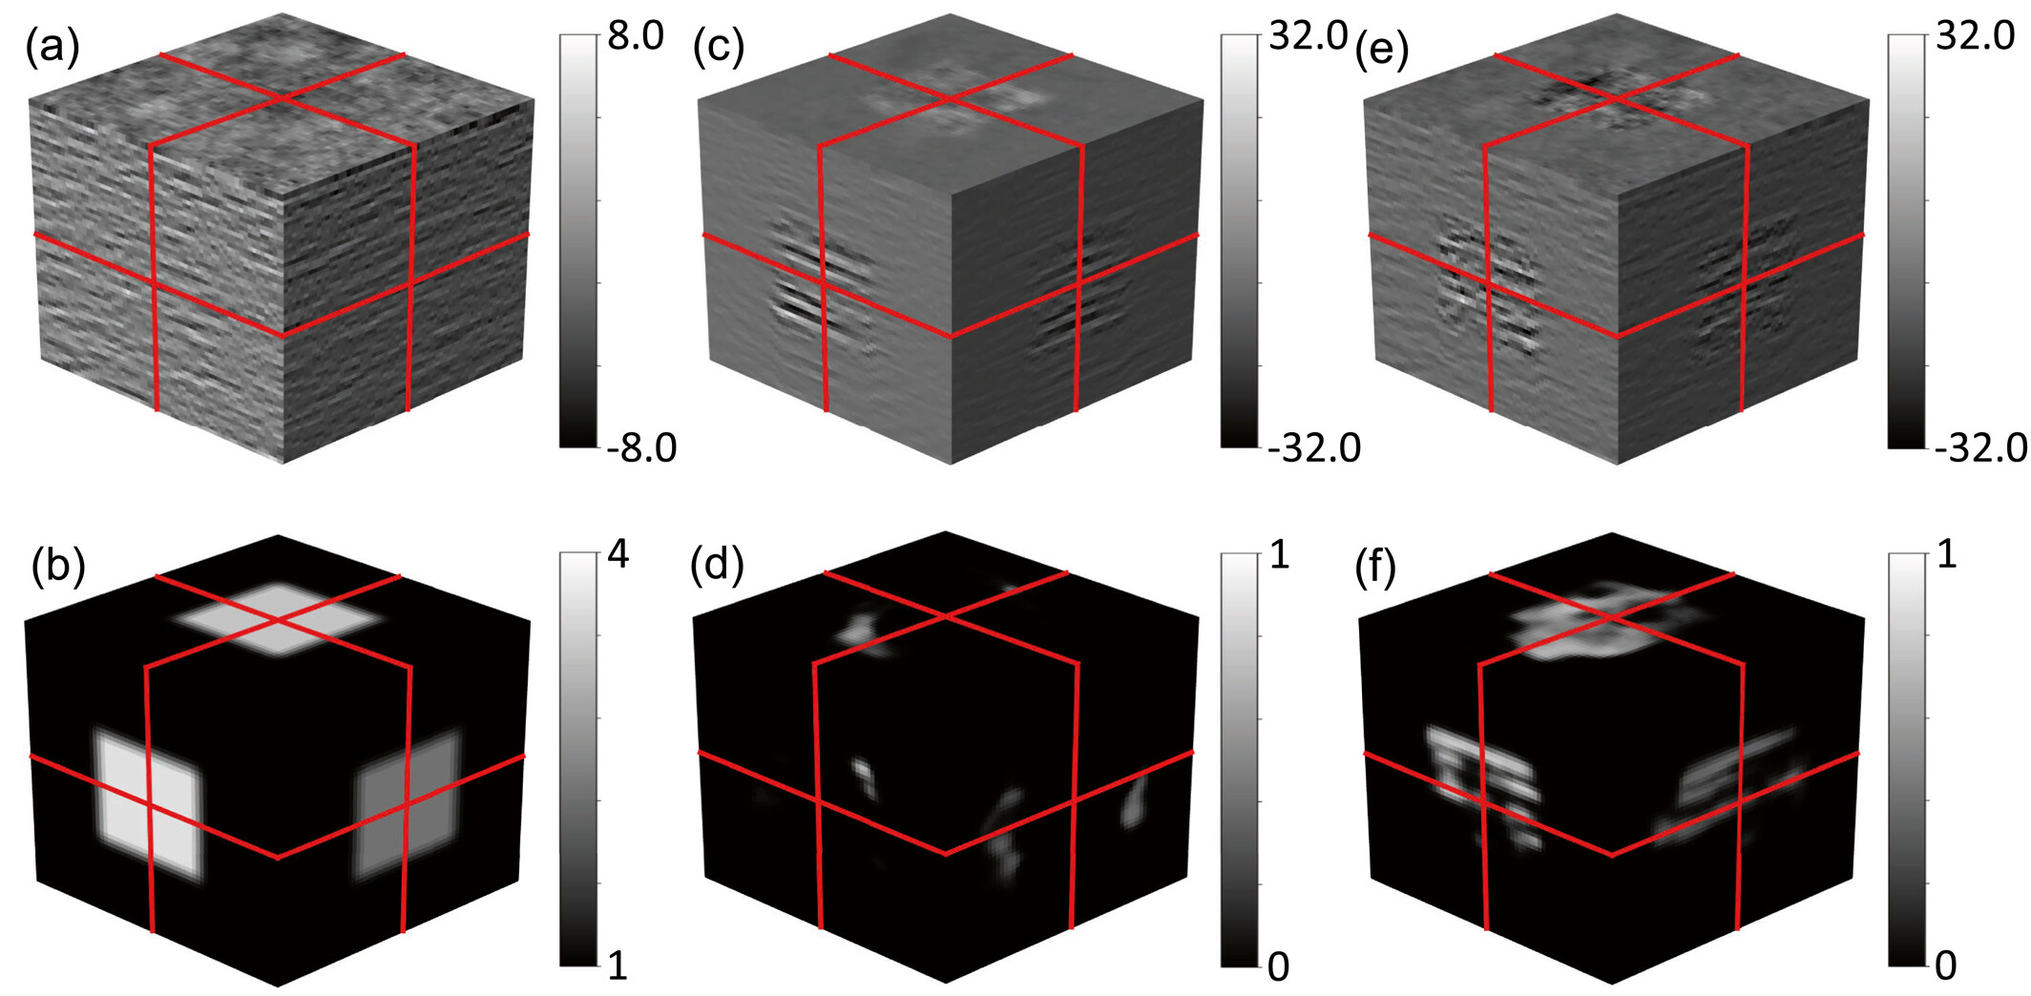
Modifications of the time-lapse images in the second sample are shown in the Figures. (a) Is the original baseline; (b) is the locally scaling multiplier; (c) and (e) are new time-lapse images obtained from locally amplifying the original time-lapse and baseline images, respectively, by (b); (d) and (f) are NN predictions corresponding to (c) versus (a) and (e) versus (a), respectively.

Slide 16
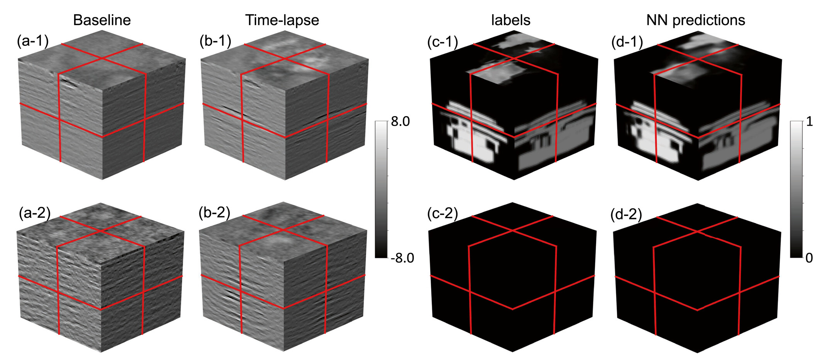
Trained NN predictions for the two samples are shown in the Figure. The first two columns are the baseline and time-lapse seismic images as the NN input, and the last two columns are the human-interpreted labels and NN predictions as CO₂ distribution probability.

Slide 17
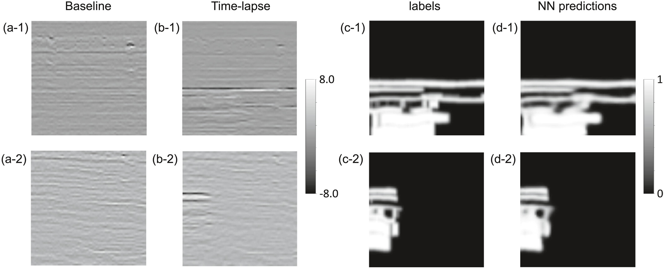
2D U-Net with Sparse 2D Labels:
Trained 2D NN predictions for two samples from the training dataset with sparse 2D slice labels.

Slide 18
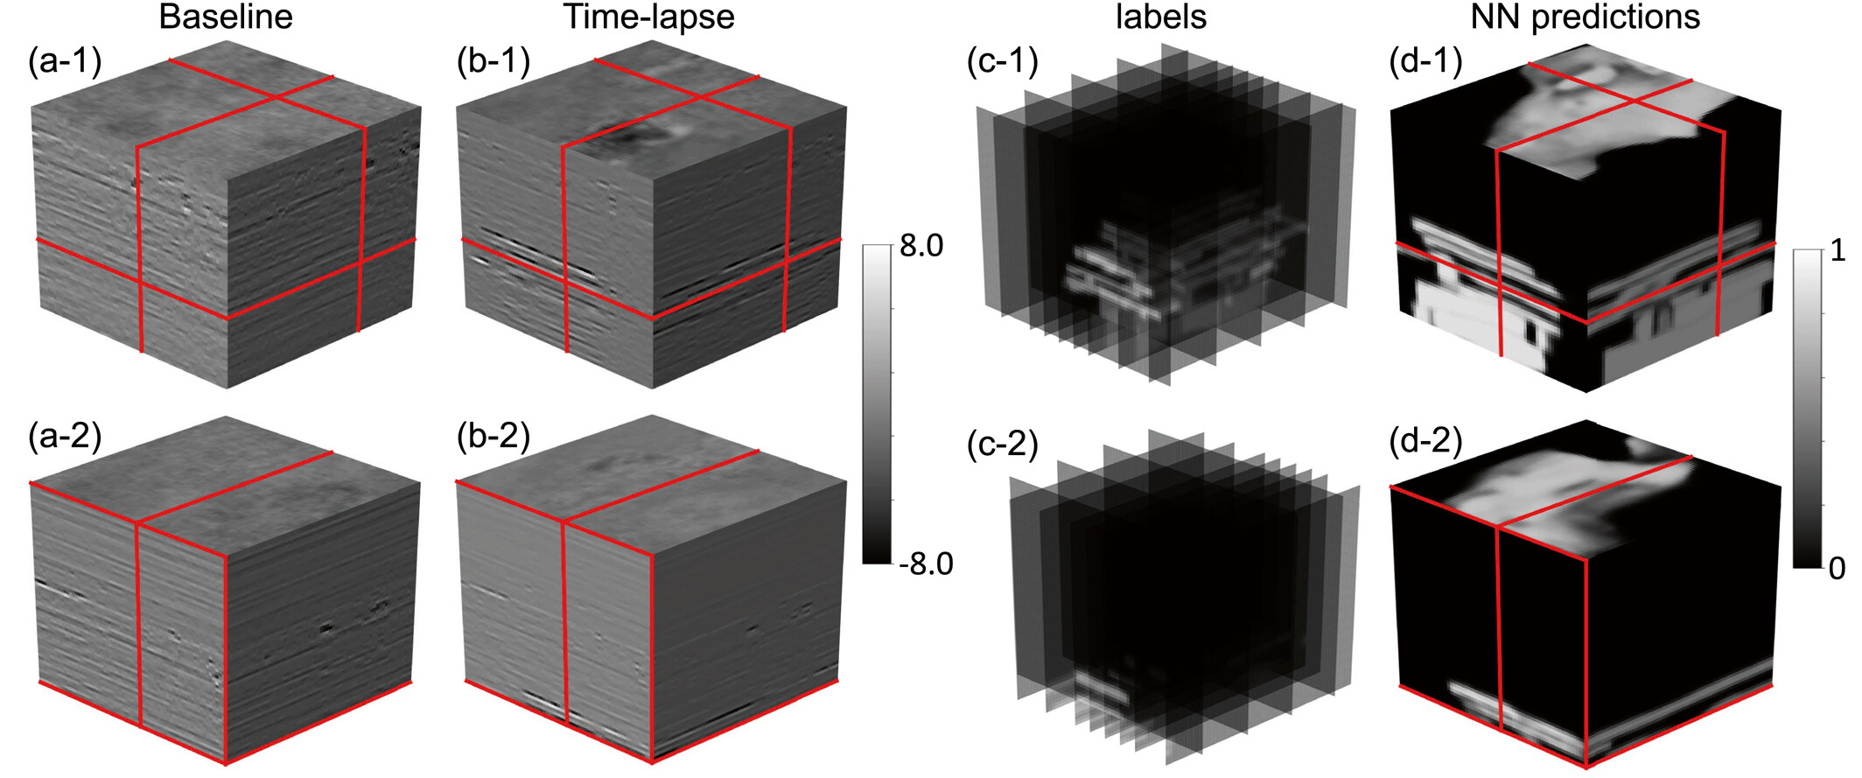
3D U-Net with Sparse 2D Labels:
Trained 3D NN predictions for two samples from the training dataset with sparse 2D slice labels. The first two columns are the baseline and time-lapse seismic images as the NN input, and the last two columns are the human-interpreted labels and NN predictions as CO₂ distribution probability.

Slide 19
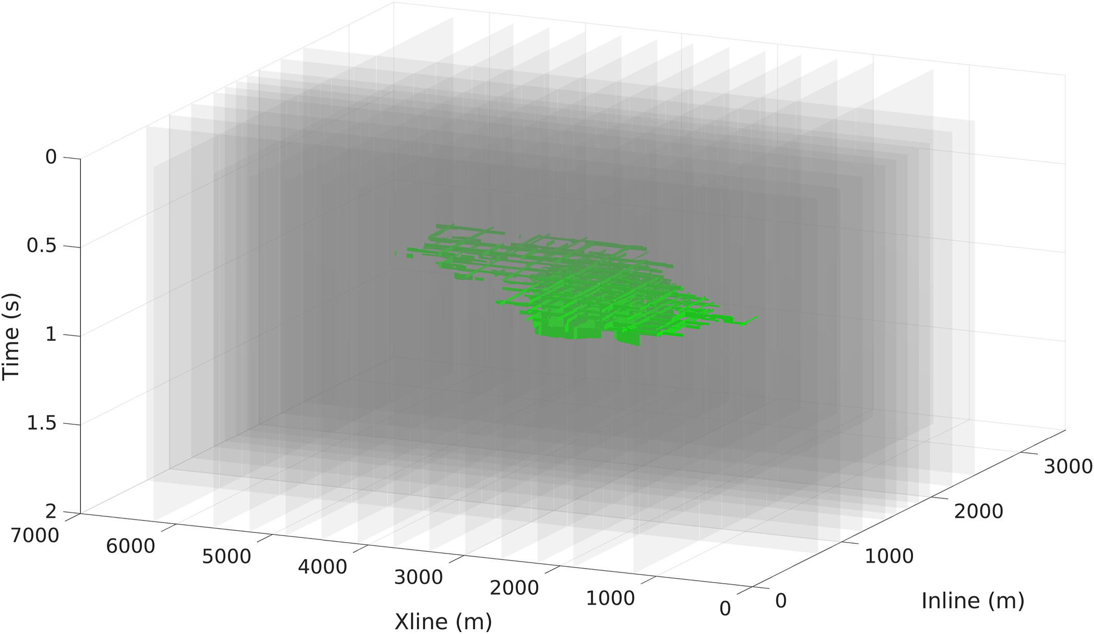
2D Versus 3D NN Using Sparse 2D Labels:
Sparse 2D slice labels of CO₂ distribution, indicated by the green patches on each slice, are represented by translucent surfaces. The slices are sampled more densely near the CO₂ storage unit along both inline and crossline directions.

Slide 20
Conclusions:
A simplified 3D U-Net was used to map 4D seismic images to 3D CO₂ distributions.
The model was trained using time-lapse seismic data processed through different workflows to enhance robustness to processing mismatch.
Through robustness testing, the model proved resilient to variations in seismic processing.
When applied to seismic data from other years, the model produced high-resolution and consistent interpretations.
The trained neural network identifies CO₂ presence based on both amplitude changes and structural similarity to baseline images.
The consistency test showed stable CO₂ plume tracking over time (1999–2010) across multiple reservoir layers.
Overall, the model demonstrated strong generalization, high spatial resolution, and potential for long-term CO₂ storage monitoring.

Slide 21
2D vs. 3D Neural Network Training for CO₂ Interpretation:
Feature | 2D Training | 3D Training
Label Type | Sparse 2D interpreted slices (e.g., horizons) | Full 3D CO₂ plume volumes
Training Cost | Low – Minimal GPU memory and compute needed | High – Intensive GPU usage and memory demand
Training Time | Fast – Suitable for rapid prototyping | Slow – Long runtimes due to larger data and model complexity
Accuracy & Resolution | Moderate – May miss vertical plume continuity | High – Detailed and continuous volumetric boundaries
Scalability | Works well on single-GPU systems | Requires multi-GPU or HPC cluster
Use Case Suitability | Best for pilot studies or limited annotations | Ideal for production CCS monitoring and regulatory reports
Data Requirements | Needs fewer and simpler labels | Requires densely labeled 3D training volumes
Generalization | Moderate – Performance may vary over time | Strong – Consistent interpretation across all time-lapse sets
GPU Type | Entry-level GPUs (e.g., RTX 3060, A2000) | High-end GPUs (e.g., A30, A100, TITAN RTX 24G)
Techniques Used | 2D CNNs, label projection, transfer learning | 3D U-Net, volumetric convolution, batch normalization
Accuracy (Typical) | ~75–85% IoU (Intersection over Union) | ~90–95% IoU (high fidelity to expert labels)
Model Complexity | Low – Fewer parameters, faster convergence | High – Larger model, deeper network layers
Post-processing | May require morphological filtering and slice merging | Minimal – Outputs are already 3D-consistent probability volumes

Slide 22
Thank You

